Slide 1
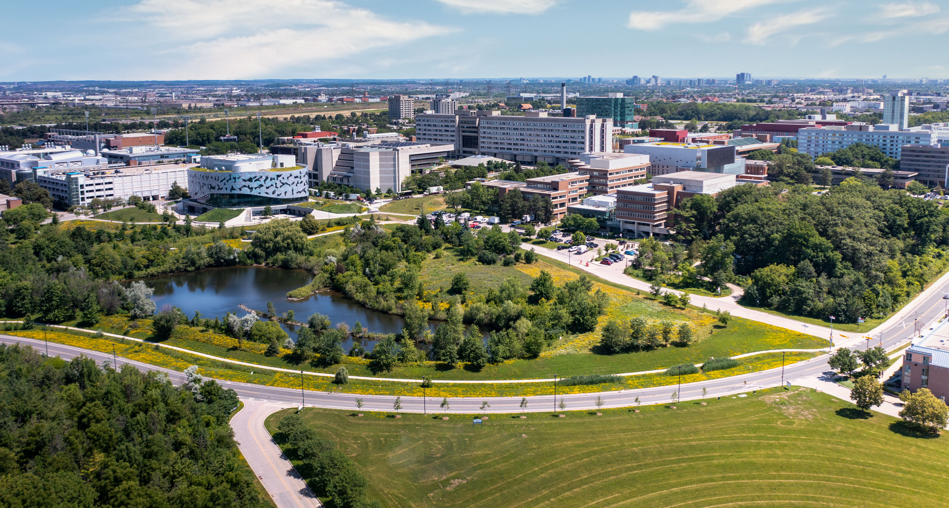
Indoor Navigation System
Shengxiong Wu - 217993254
Haochen Wang - 216754236
EECS4080/EECS4090

Slide 2
Introduction
Motivation
Some classroom is hard to identified/found
Freshman each year looking for classrooms

Slide 3
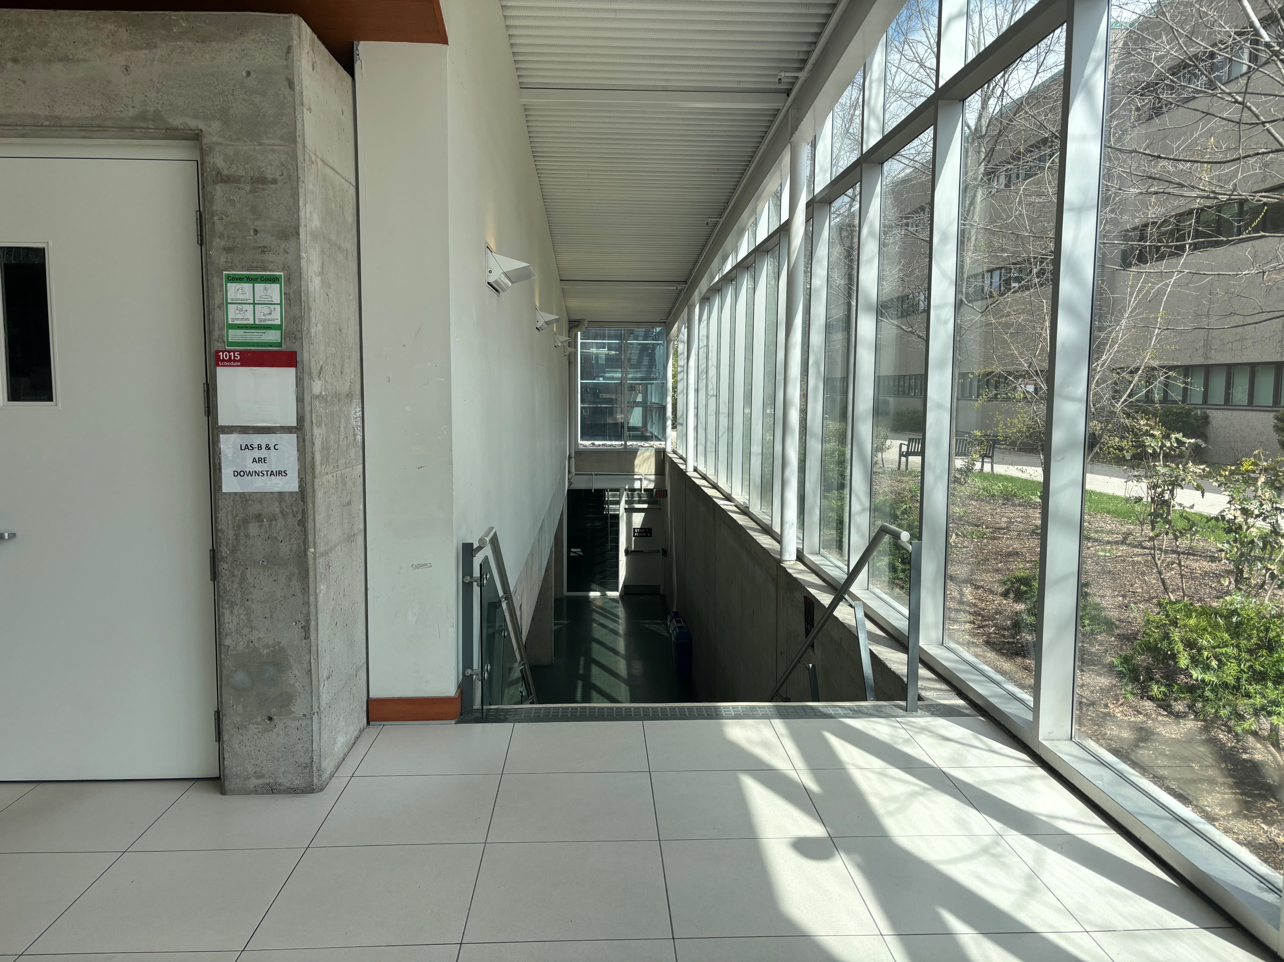
Example – Lassonde Lecture Hall C

Slide 4
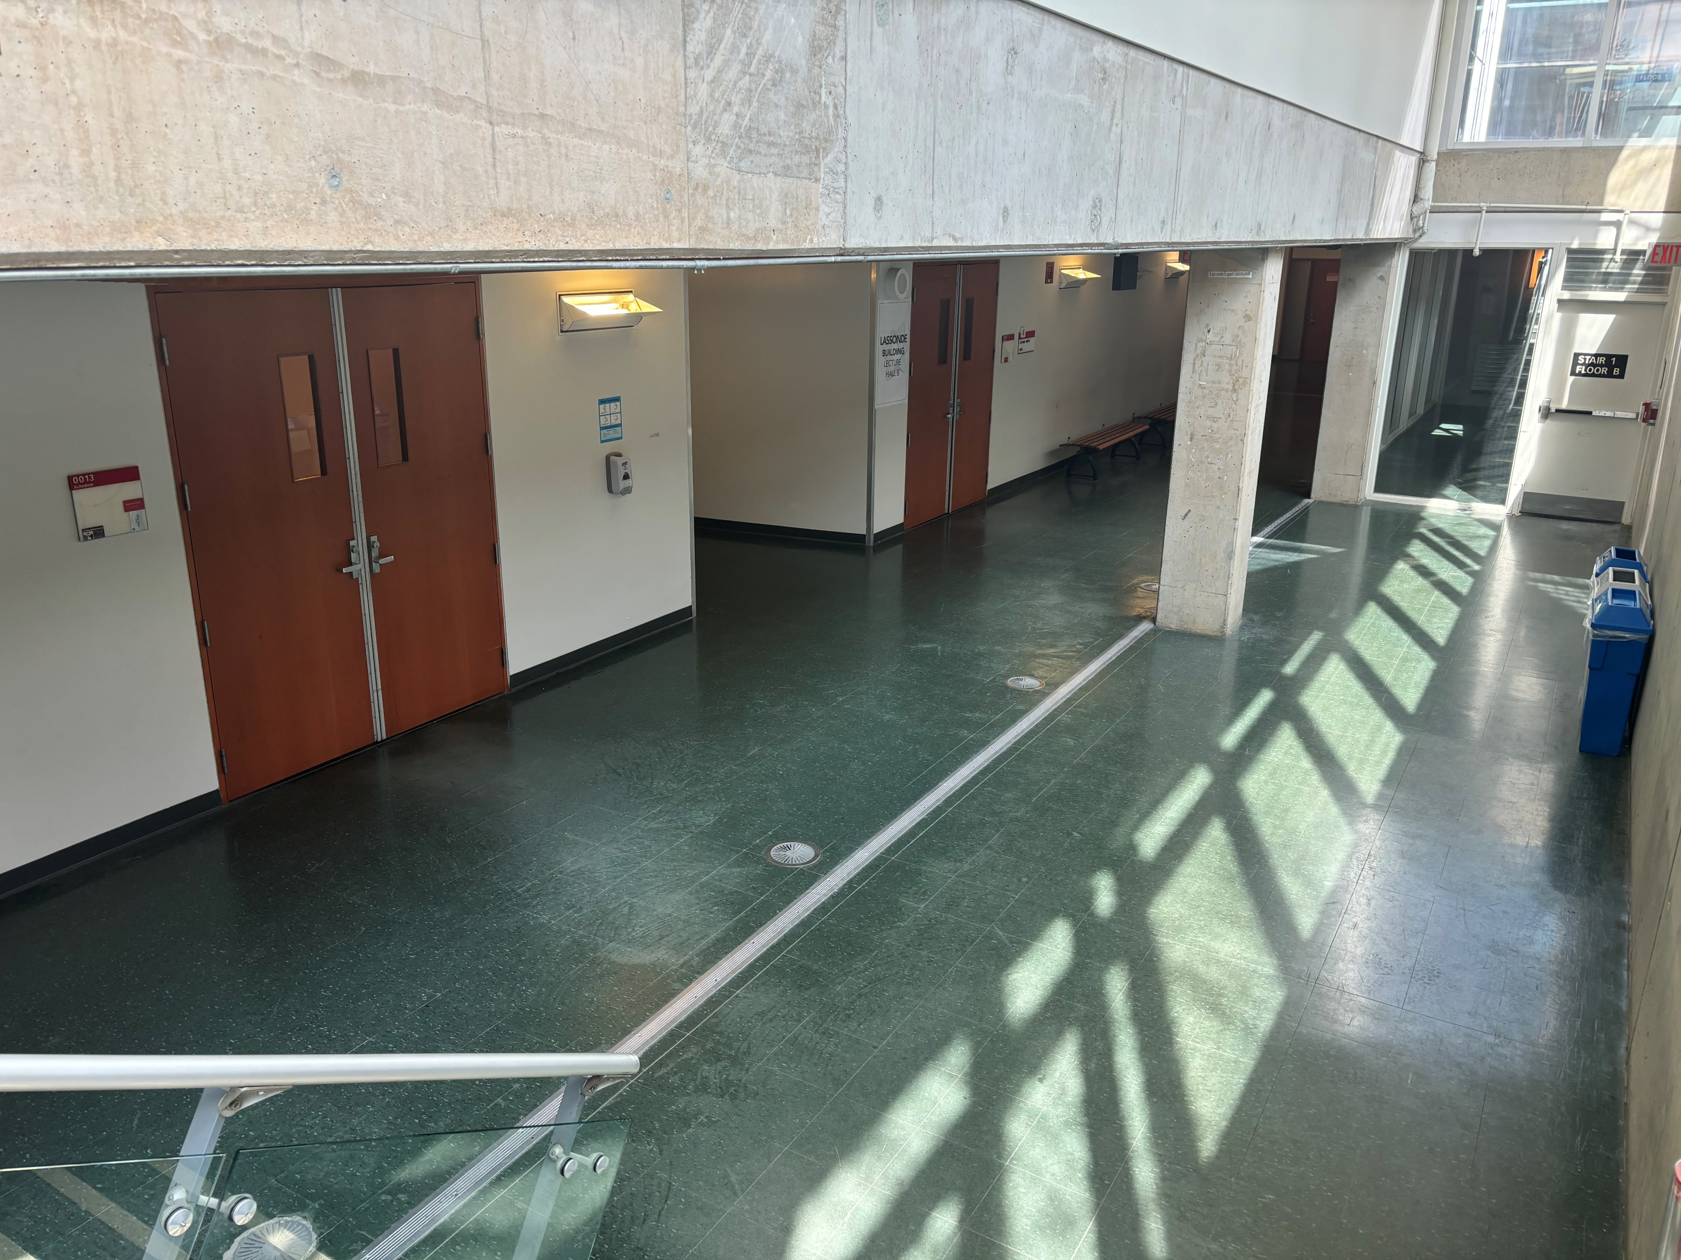
Example – Lassonde Lecture Hall C

Slide 5
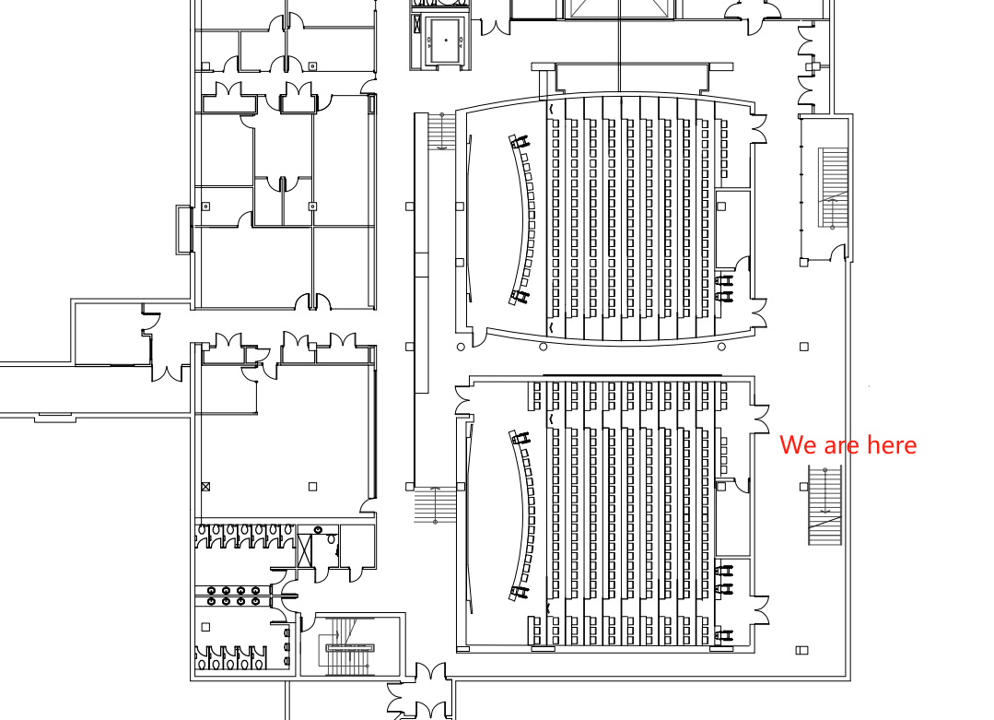
Example – Lassonde Lecture Hall C

Slide 6
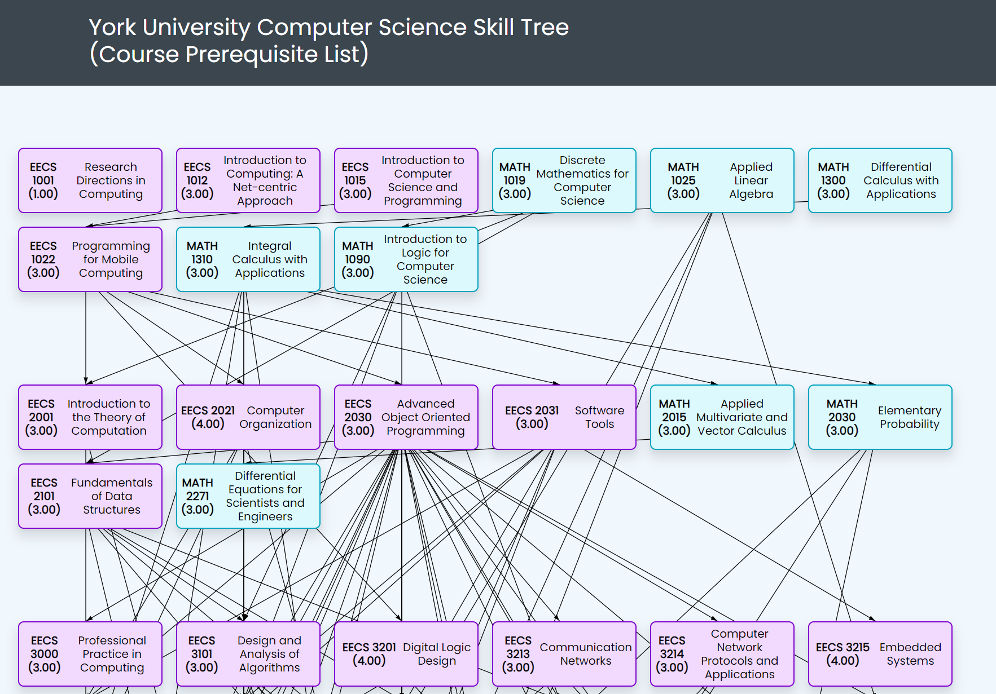
Introduction
Motivation
Make contribution to York University Community
York University Computer Science Skill Tree

Slide 7
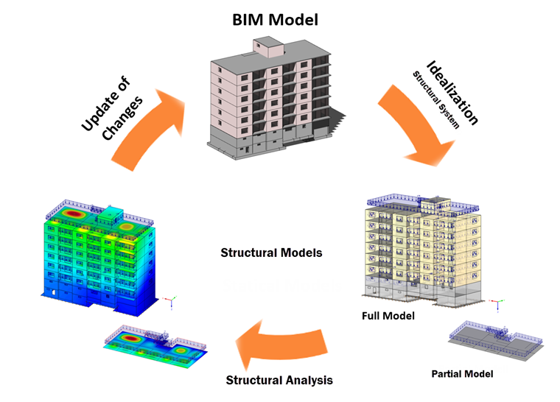
Introduction
Goal
Develop an indoor navigation system
Save time
Contribute to the York University Community
Context
Google Map can not navigate inside the building
Common indoor navigation system (e.g., in the mall) required BIM (Building Information Model)
Web-based application that can navigate inside the building on campus

Slide 8
Software Development Life Cycle
Requirements Analysis
Design
Development
Testing
Deployment
Maintenance

Slide 9
Requirements Analysis
Functional Requirement:
Navigation Function
User Interface
Multi-floor support
Multi-building support
Non-Functional Requirement:
Response Time
Data Safety
Scalability
Technical Requirements:
Spring Boot
Web-development tech stack
Cloud deployment

Slide 10

Design - Methodology
Shortest Path?
Single-source shortest path problem
Dijkstra’s Algorithm!

Slide 11
Dijkstra’s Algorithm
Current Node: A
B
Current Queue:
Used Node:
Vertex | Distance | Path
A | 0 | -
B | INF
C | INF
D | INF
8
7
D
A
C
3
3

Slide 12
Dijkstra’s Algorithm
Current Node: A
B
Current Queue: B
Used Node:
Vertex | Distance | Path
A | 0 | -
B | 8 | A->B
C | INF
D | INF
8
7
D
A
C
3
3

Slide 13
Dijkstra’s Algorithm
Current Node: A
B
Current Queue: B, C
Used Node:
Vertex | Distance | Path
A | 0 | -
B | 8 | A->B
C | 3 | A->C
D | INF
8
7
D
A
C
3
3

Slide 14
Dijkstra’s Algorithm
Current Node: B
B
Current Queue: C
Used Node: A
Vertex | Distance | Path
A | 0 | -
B | 8 | A->B
C | 3 | A->C
D | INF
8
7
D
A
C
3
3

Slide 15
Dijkstra’s Algorithm
Current Node: B
B
Current Queue: C, D
Used Node: A
Vertex | Distance | Path
A | 0 | -
B | 8 | A->B
C | 3 | A->C
D | 8+7 = 15 | A->B->D
8
7
D
A
C
3
3

Slide 16
Dijkstra’s Algorithm
Current Node: C
B
Current Queue: D
Used Node: A, B
Vertex | Distance | Path
A | 0 | -
B | 8 | A->B
C | 3 | A->C
D | 8+7 = 15 | A->B->D
8
7
D
A
C
3
3

Slide 17
Dijkstra’s Algorithm
Current Node: C
B
Current Queue: D
Used Node: A, B
Vertex | Distance | Path
A | 0 | -
B | 8 | A->B
C | 3 | A->C
D | 3+3=6 | A->C->D
8
7
D
A
C
3
3

Slide 18
Dijkstra’s Algorithm
Current Node: D
B
Current Queue:
Used Node: A, B, C
Vertex | Distance | Path
A | 0 | -
B | 8 | A->B
C | 3 | A->C
D | 6 | A->C->D
8
7
D
A
C
3
3

Slide 19
Dijkstra’s Algorithm
Current Node:
B
Current Queue:
Used Node: A, B, C, D
Vertex | Distance | Path
A | 0 | -
B | 8 | A->B
C | 3 | A->C
D | 6 | A->C->D
8
7
D
A
C
3
3

Slide 20
Methodology
Graph
Node
Edge
Draw the path on the floor plan
Floor Plan
Room, Door, Stair, and Intersection
Corridor

Slide 21
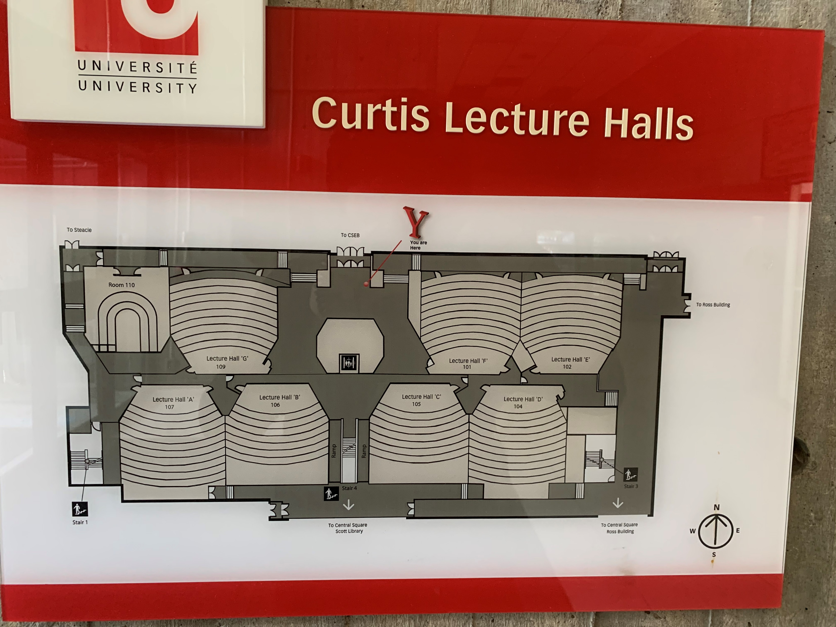
Collection of the Floor Plan Data
Research
Map Library
Floor Plan on the wall

Slide 22
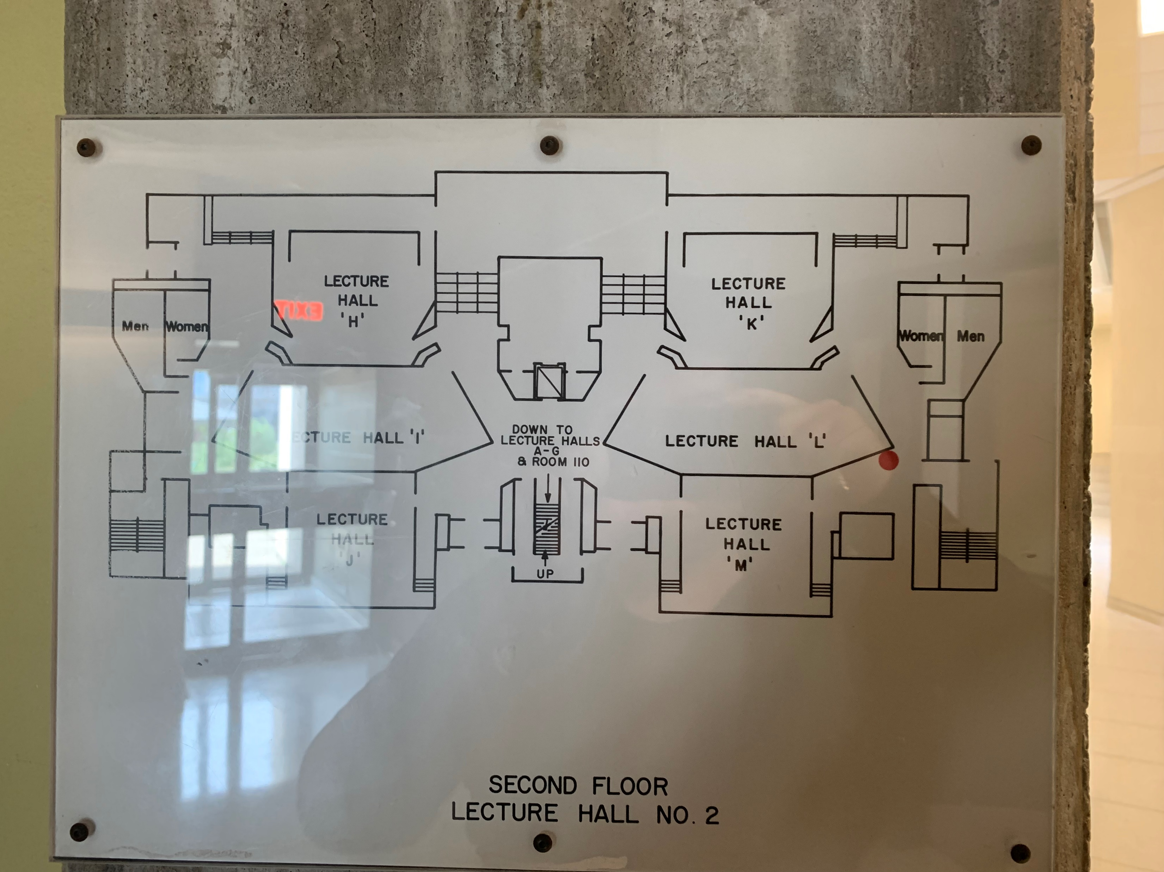
Floor Plan for CLH Level 2 by Photo

Slide 23
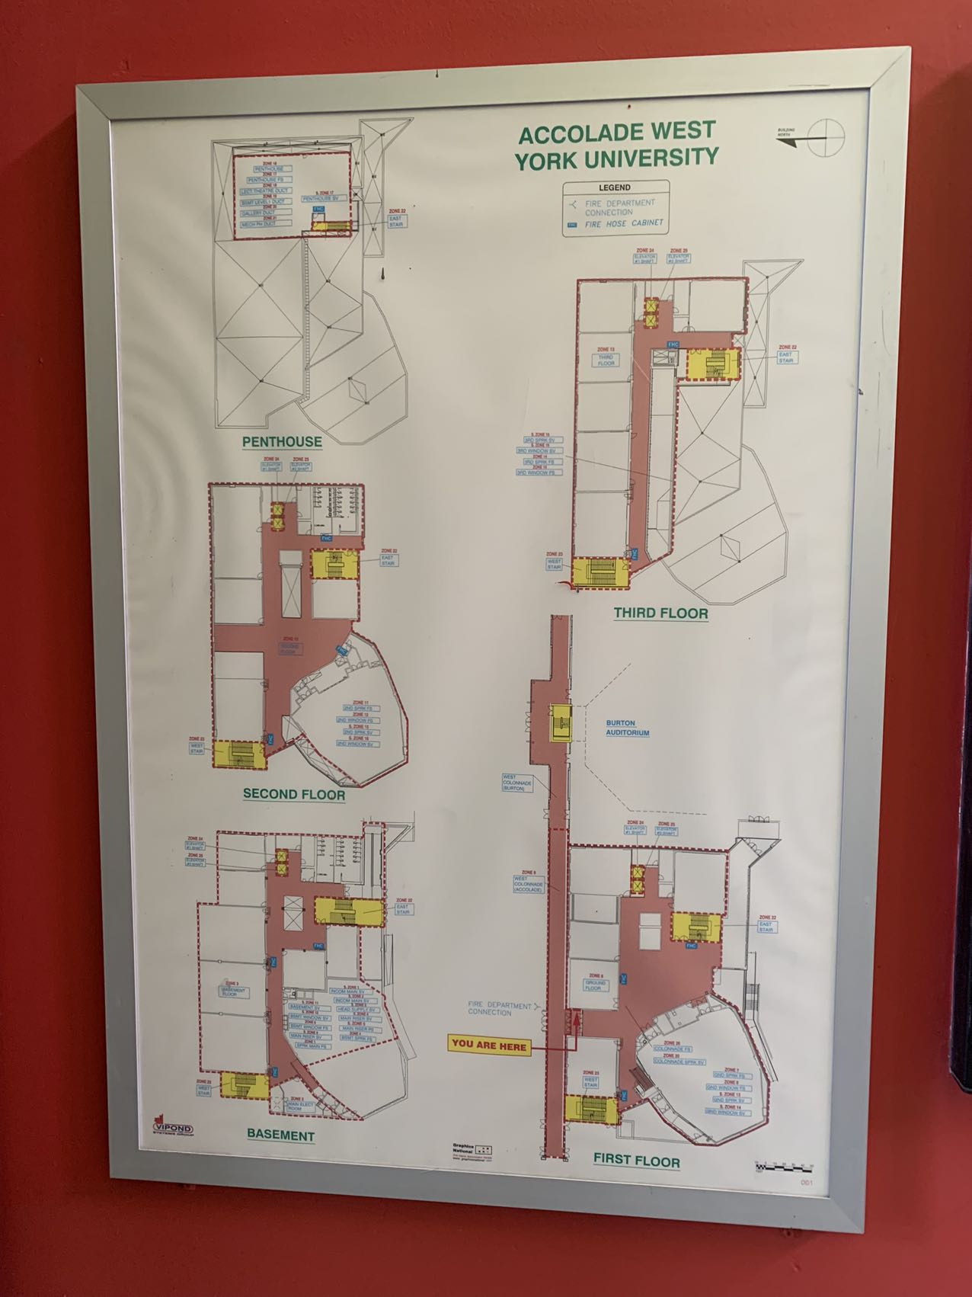
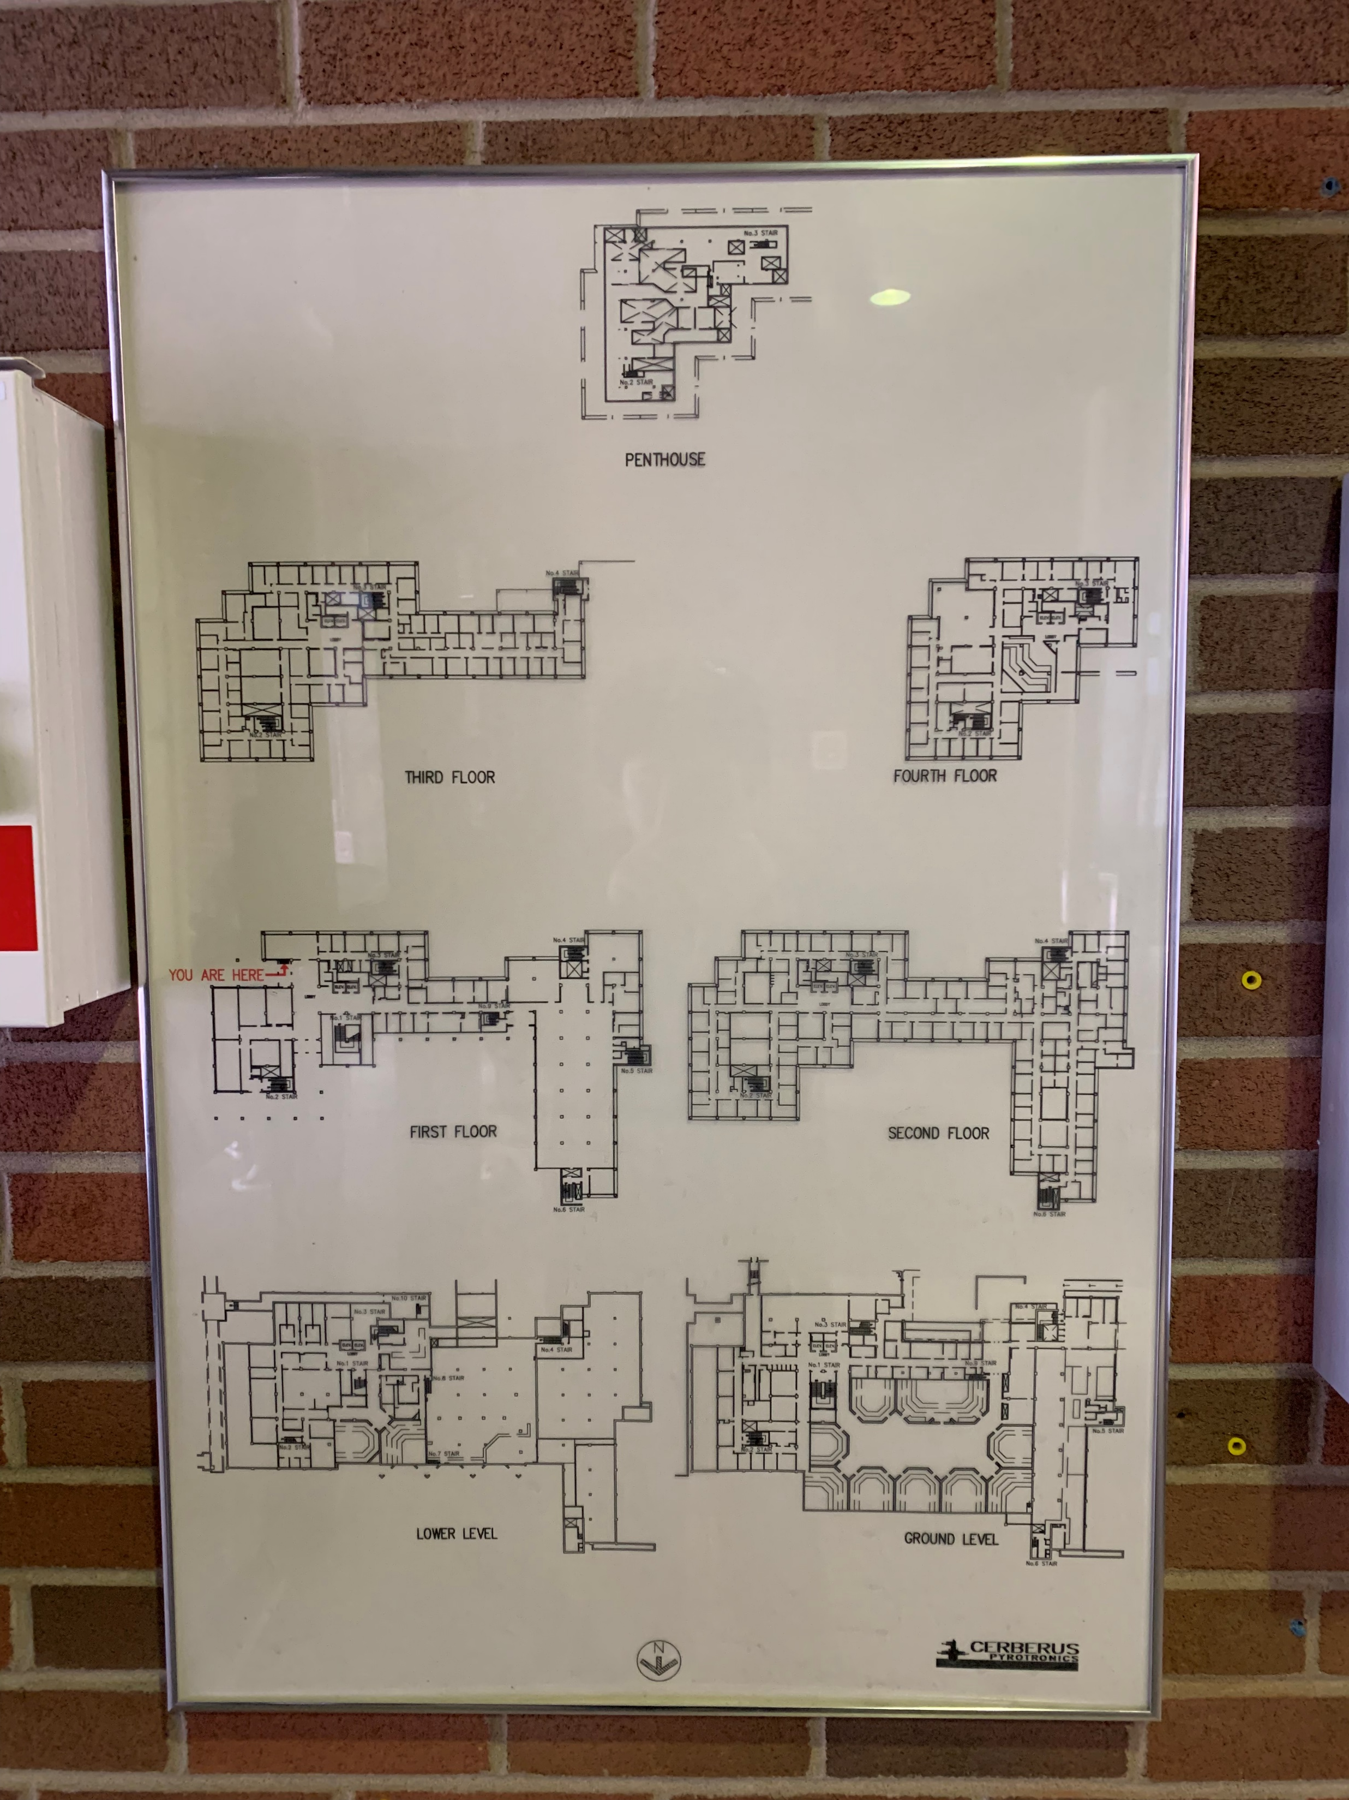
The format of floor plans varies across different buildings

Slide 24
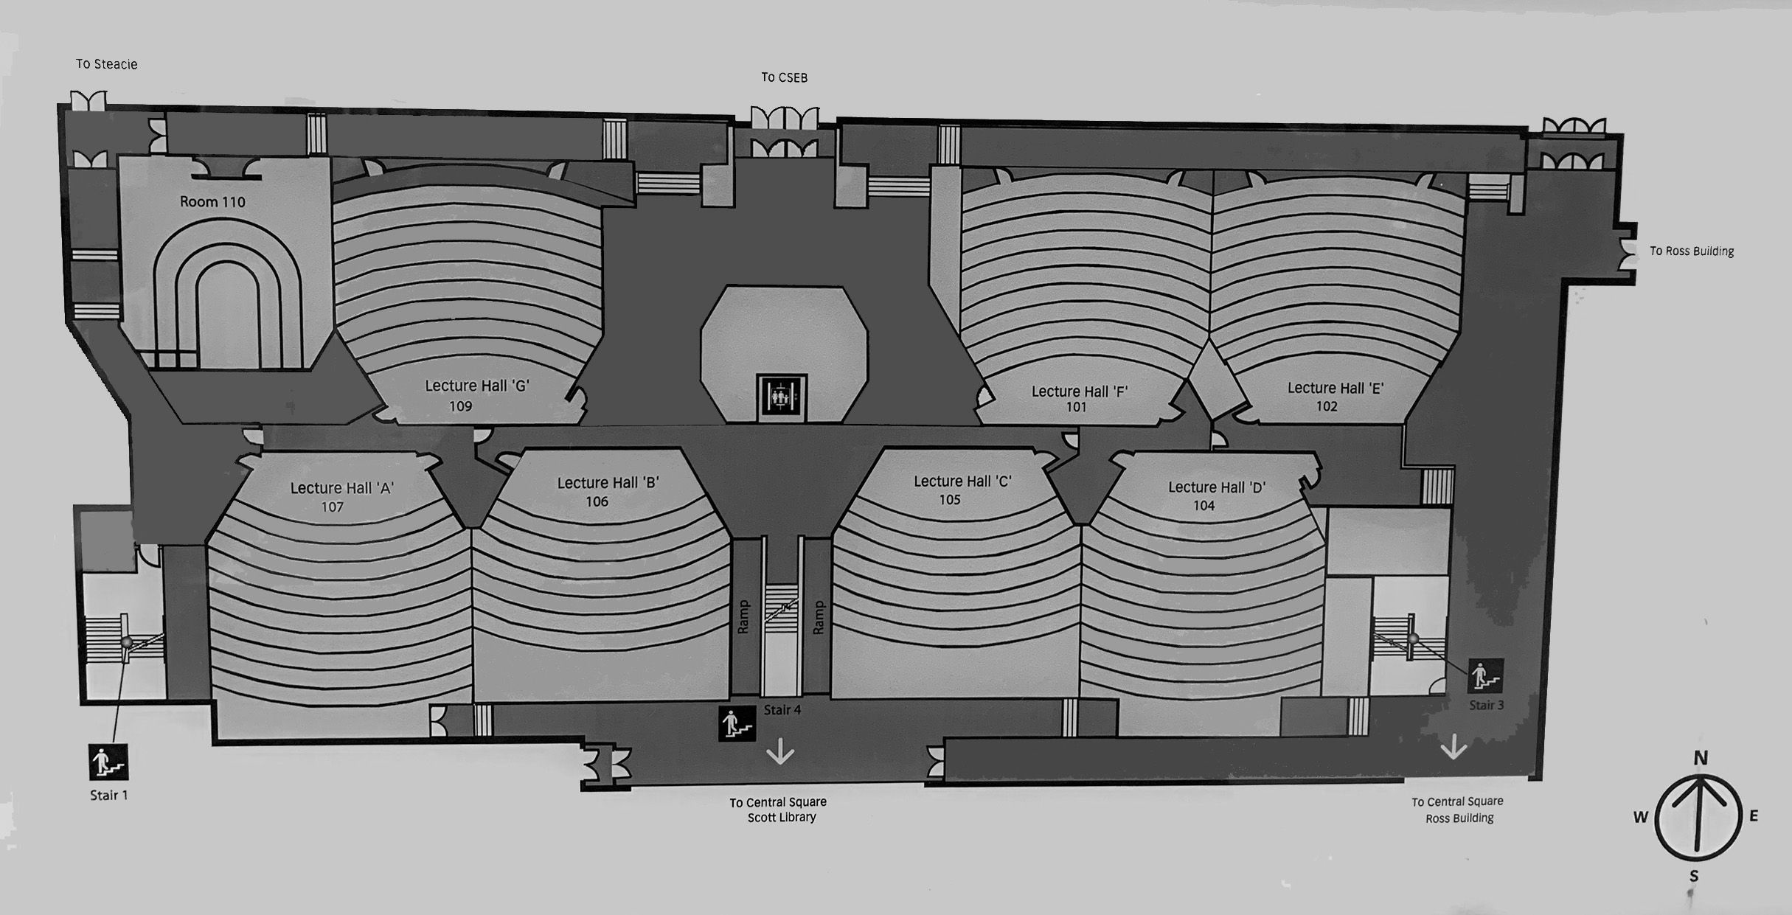
Preprocessing of the Floor Plan Image
Size
Position & Aspect
Color

Slide 25
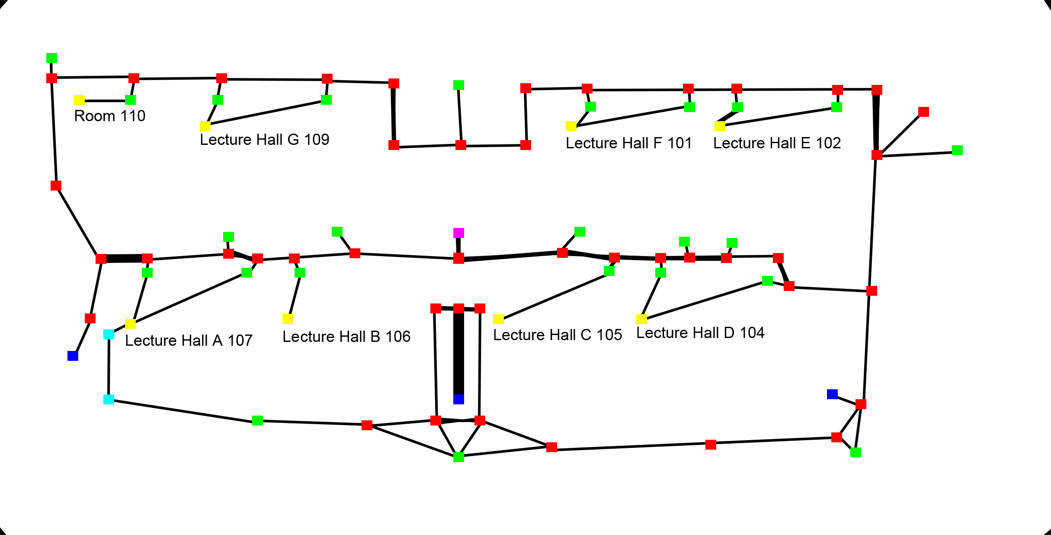
Extract and Encode Information from the Floor Plan
POIs (Point of Interest)
as vertices (nodes)
Pathways
as edges
Drawn by Photoshop
POI type encoded with color
Notated image parsed by backend with CV (Computer Vision)
Graph serialized into database

Slide 26
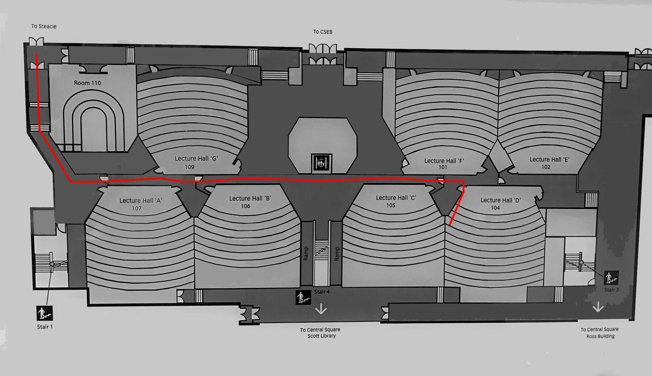
Backend Logic
Obtain the user input
the source and destination node
Automatic Pathfinding
Apply Dijkstra's algorithm
Route is drawn onto the floor plan image as pixels
Return image to the frontend

Slide 27
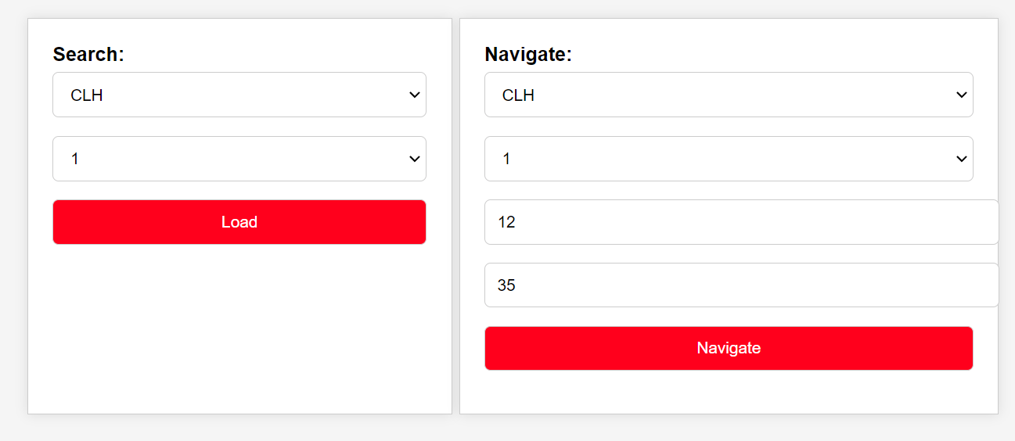
First Functional Prototype

Slide 28
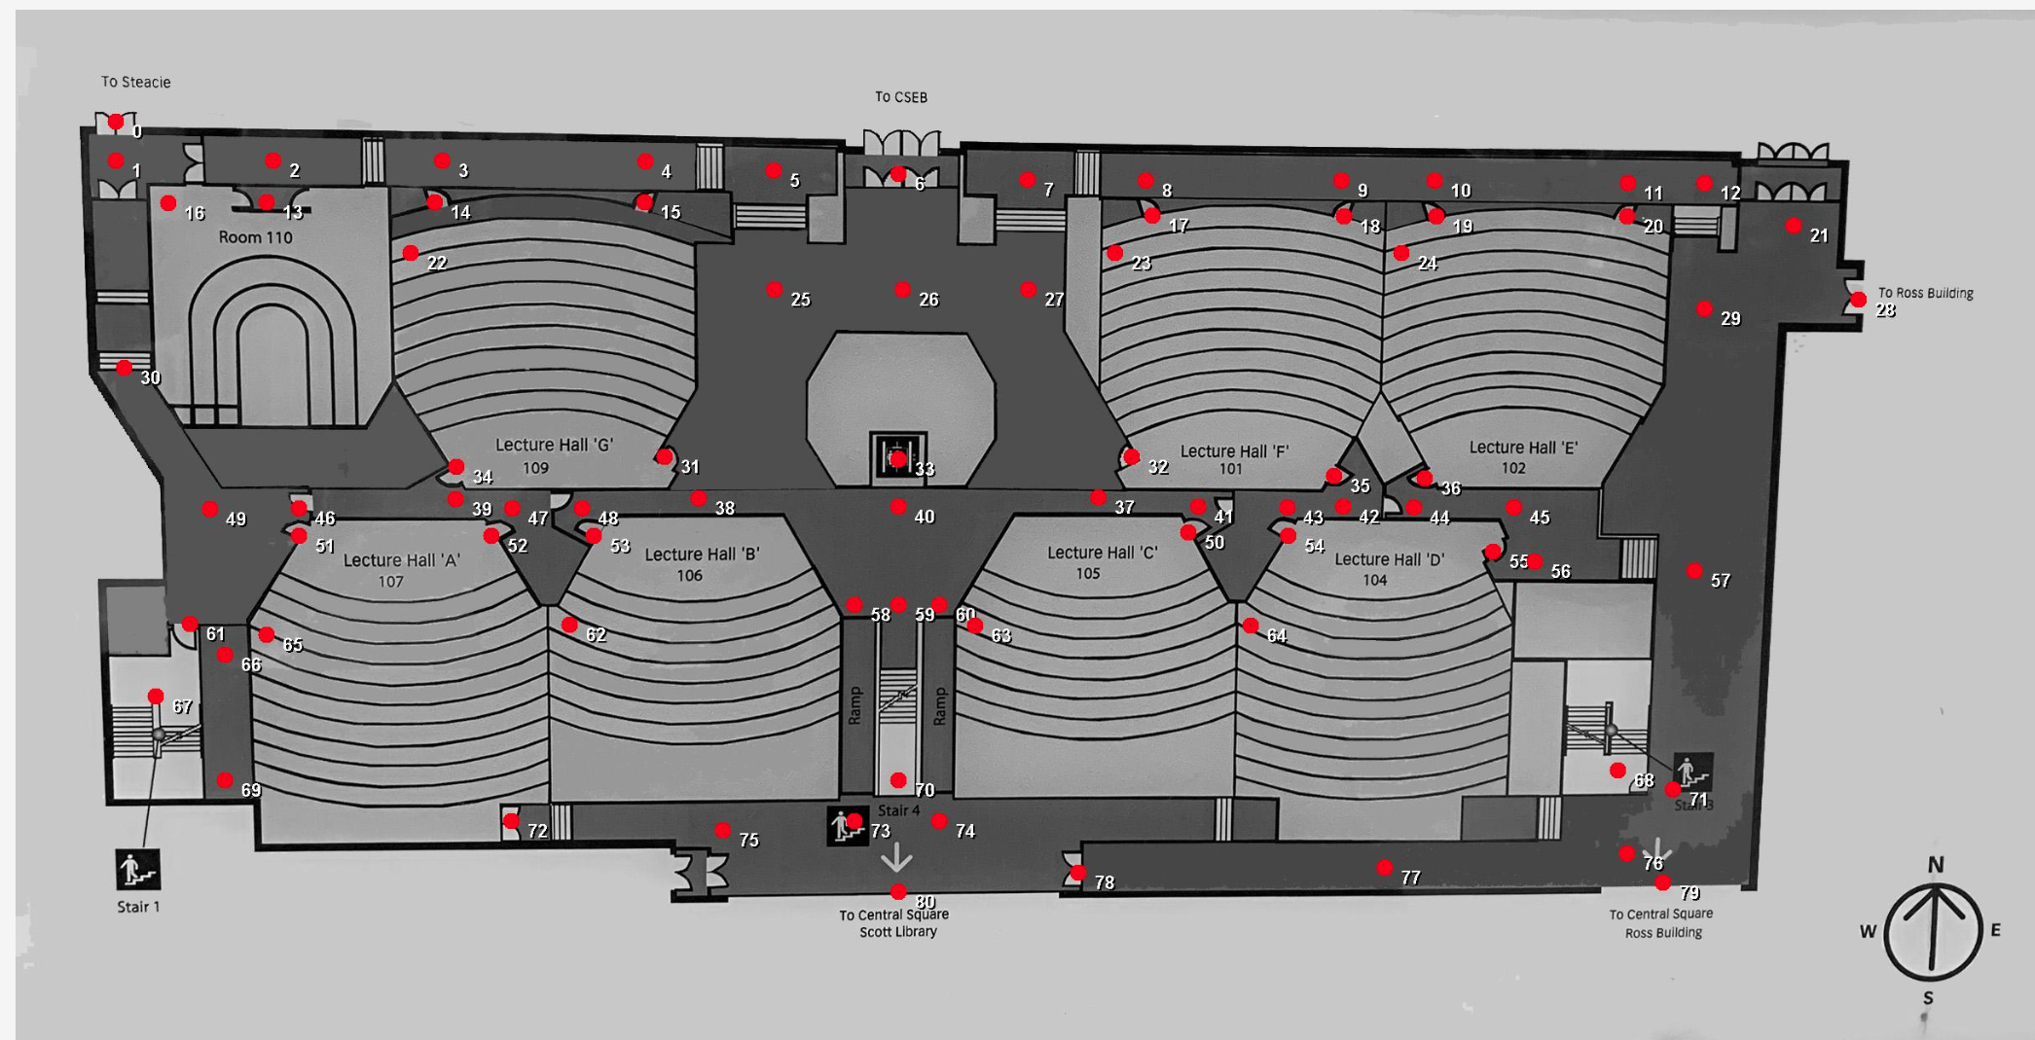
First Functional Prototype

Slide 29
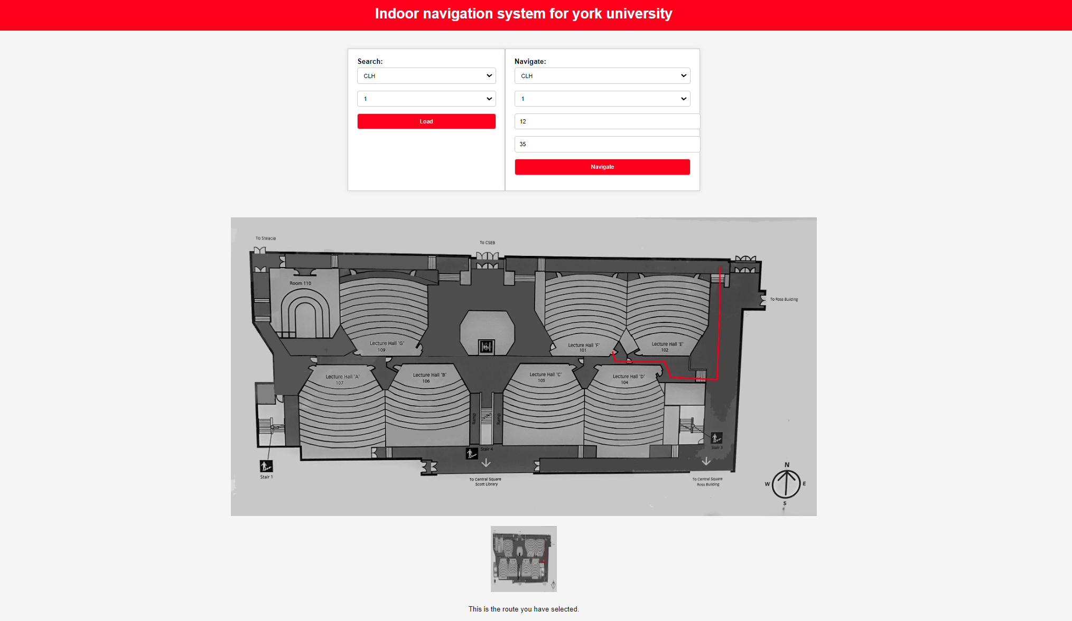
First Functional Prototype

Slide 30
Problems
Needs better quality floor plan images
Needs more efficient way to extract information
Needs to navigate by using room name rather than node index

Slide 31
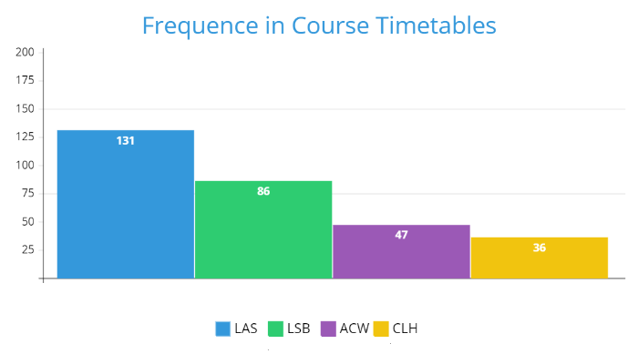
Help from Facilities Services/Campus Planning, Design & Construction
Request of CAD drawings
Up to 5 buildings
By course classroom popularity
LAS (Lassonde Building)
LSB (Life Sciences Building)
ACW (Accolade Building West)
CLH (Curtis Lecture Halls)
R (Ross Building)

Slide 32
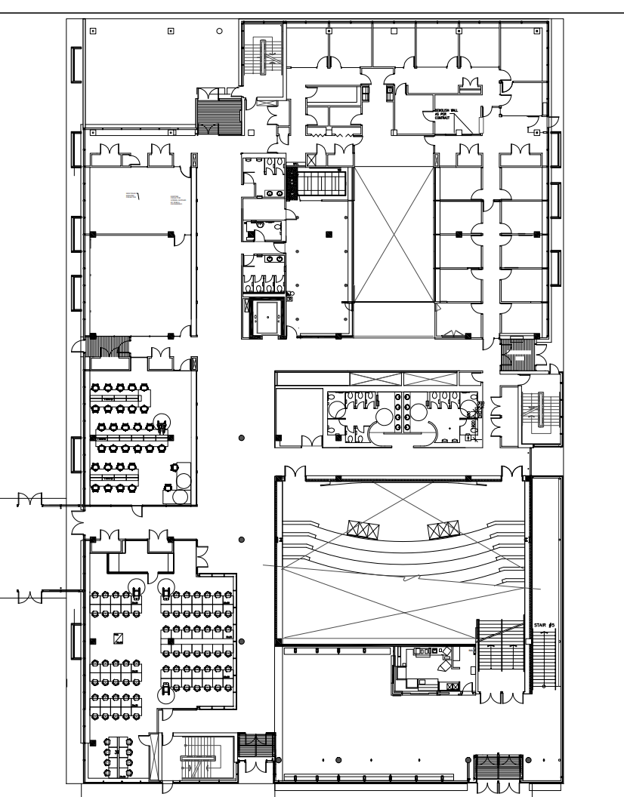
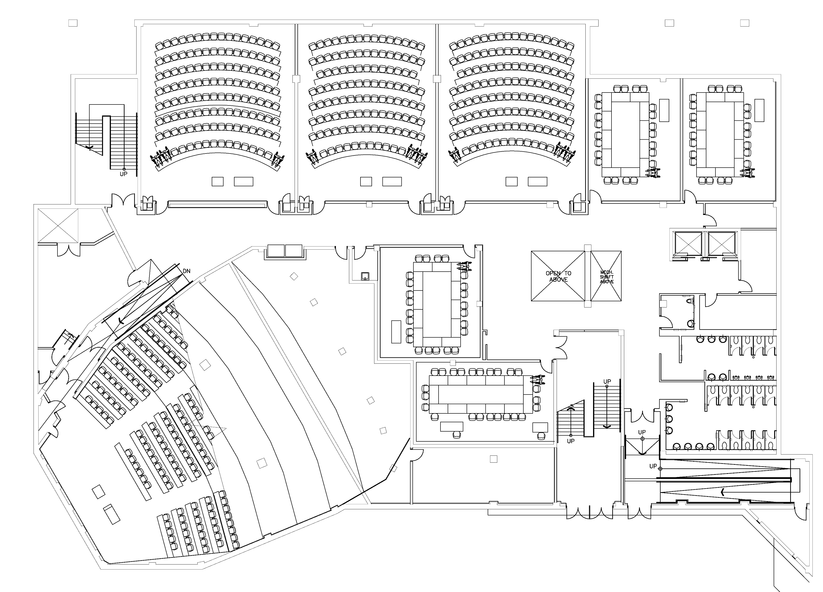
Digital Floor Plan

Slide 33
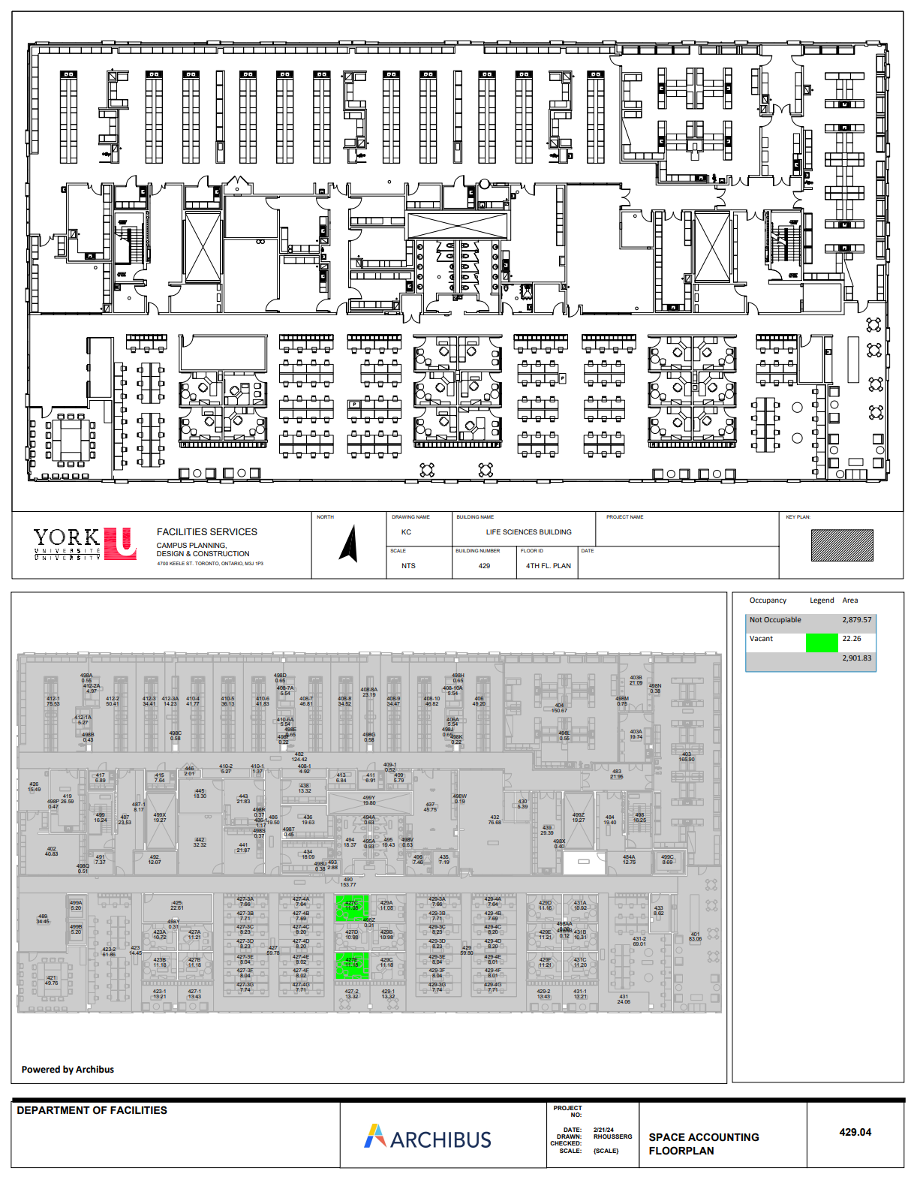
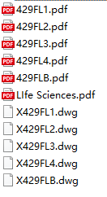
An Improved Notation Tool
Vector drawings delivered
Manual notating is still needed for now
Self-contained? Easy to use? Intuitive?

Slide 34
Notation Tool: Requirement Analysis
Needs to ready-to-use
Small footprint
Internet connection independent
Works locally with only the floor plan image
Save to local then deploy to backend
Should be as intuitive as possible
Similar mode as the last generation solution
Point-and-click interaction

Slide 35

Notation Tool: Requirement Analysis
Performance shall be acceptable
As many as several hundred nodes on a single floor
Web-based solution with HTML + CSS + JS
HTML5 Canvas
Render anything controlled by JS
Not very easy to use!

Slide 36
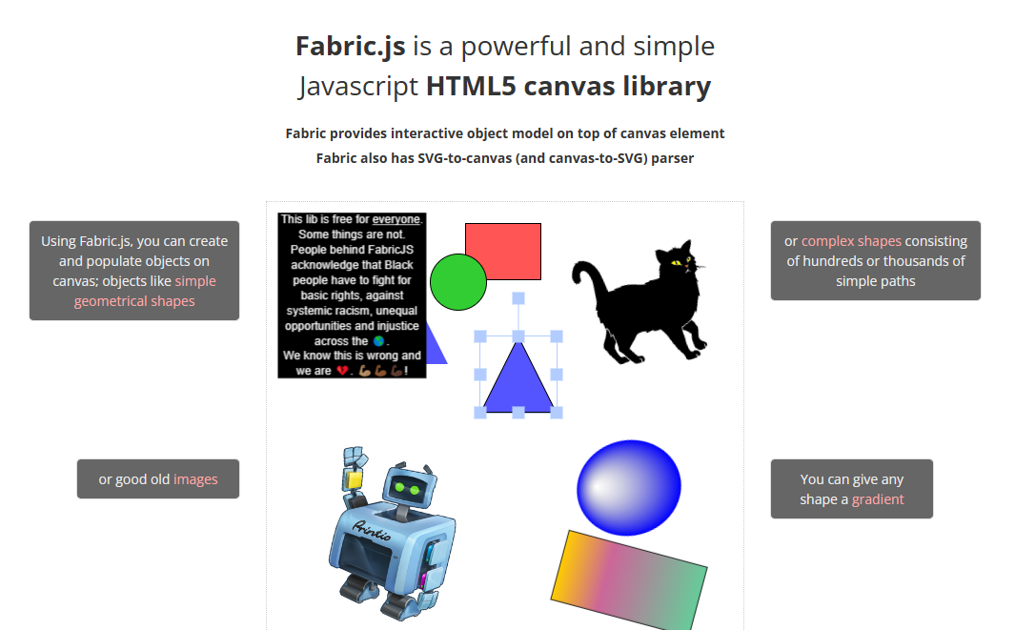
Enter Fabric.js

Slide 37
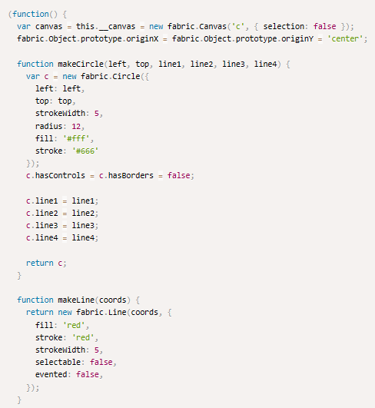
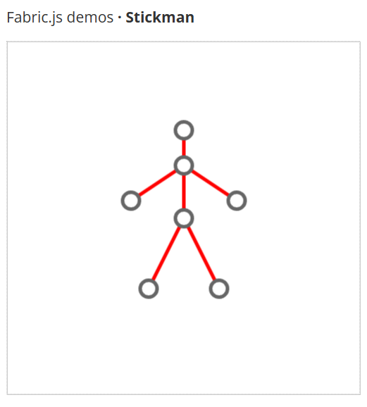
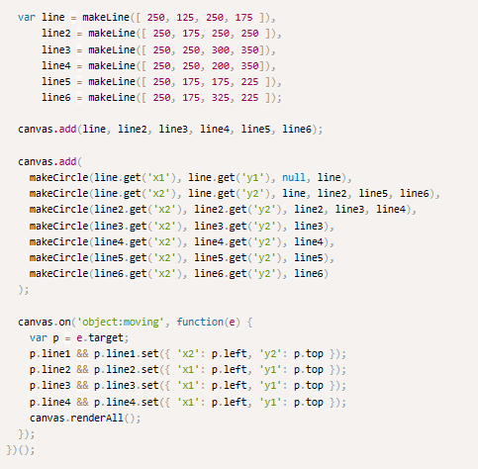
Looks familiar…

Slide 38
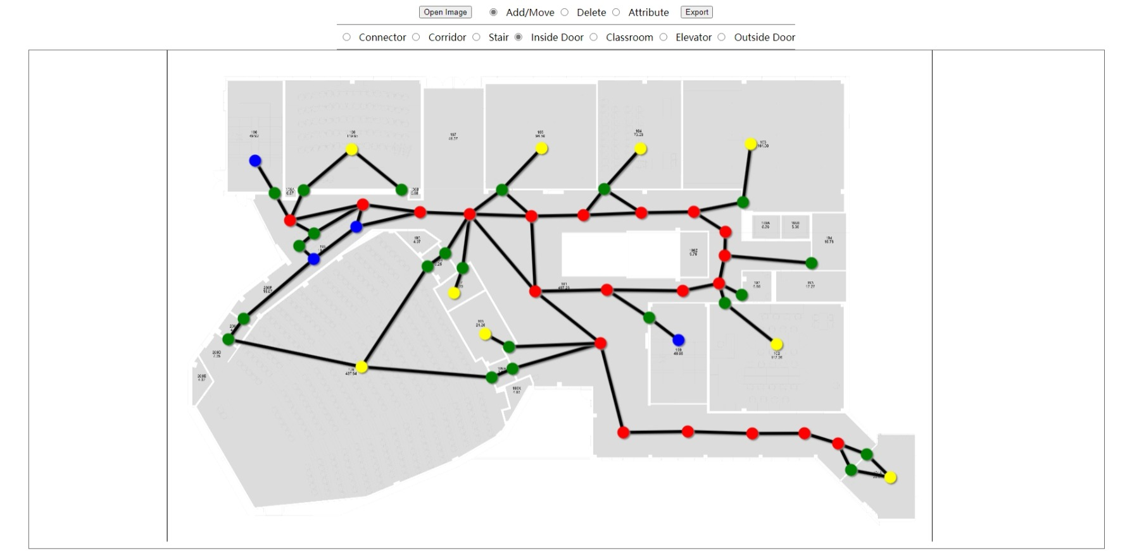
Notation Tool: Prototype

Slide 39
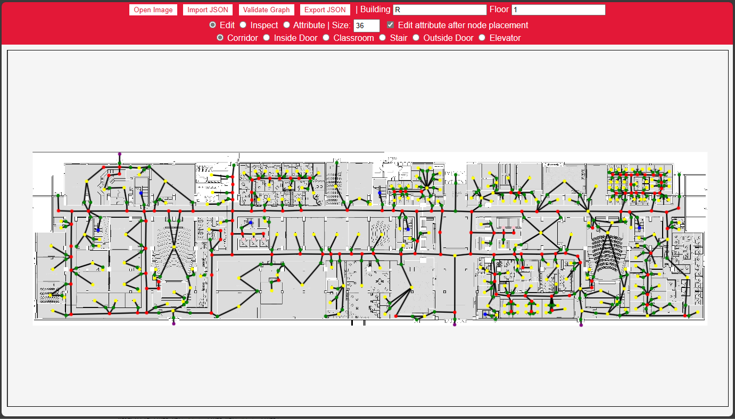
Notation Tool: Current State

Slide 40
Notation Tool: Efficiency
Tested with Ross Floor 1
Tested with CLH Floor 1
More than 40% faster

Slide 41

Result Caching
Generating the result images is SLOW!
~3 – 5 s for a single image
How to improve?
Key to the solution:
results are unique w/ each route selected
Reusing is possible!
On-server cache needed
Unique key, Put, Contains, TTL
Unique key source
Route information → [?] → Unique key
Hashing
Start: CLH Floor 1 - Lecture Hall A
End: LAS Floor 1 - 1005-WC
navigate
CLH1_LectureHallA -> Campus_CLH
Campus_CLH -> Campus_LAS
Campus_LAS -> LAS1_1005-WC
getResultFileName

Slide 42


Result Caching
Popular cache database: Redis
Fast
Easy to deploy and use
Comes with everything we need
Not optimized for large binary storage
In memory!
Local filesystem
Unique Key: Filename
Put, Contains
TTL: Last Modified w/ scheduled cronjob
Another reason
Will talk about that in a second

Slide 43

Cloud Deployment
It’s a web application
Several things needed to deploy
Virtual Private Server (VPS)
Domain
TLS Certificate
VPS
Amazon Web Service Lightsail
Domain
Registered personal domain
DNS provider: Aliyun
Certificate
Let’s Encrypt
Free renewable cert for 3 months
ACME; certbot

Slide 44
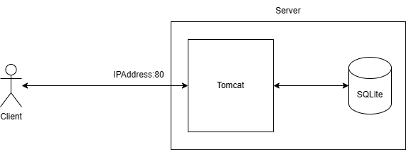
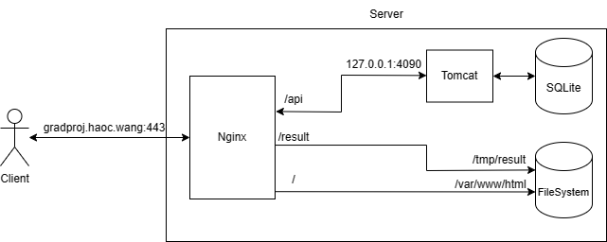
Cloud Deployment
Spring Boot’s built-in Tomcat is not very easy to configure
Compatibility with certbot
Performance
Reverse Proxy
Nginx
Popular web server
Powerful proxy and rule configuration
Built-in support from certbot
Native-level local filesystem serving
Serve result cache from disk

Slide 45
Live Demonstration
https://gradproj.haoc.wang

Slide 46
Future Work
Improve the efficiency of the backend logics
Using Deep Learning or other CV techniques to automatically build the data from floor plan
Build the data in real time and location by using robot in the building

Slide 47

Thank You
Q&A and Defending Time
Shengxiong Wu – 217993254 – sxwu@my.yorku.ca
Haochen Wang – 216754236 – whc2001@my.yorku.ca

